Slide 1

Police Data Challenge
Dave Ho
Santosh Tatipamula
Alexander Vu
Tyler Shockley
Luke Liu
The Bayes Team

Slide 2
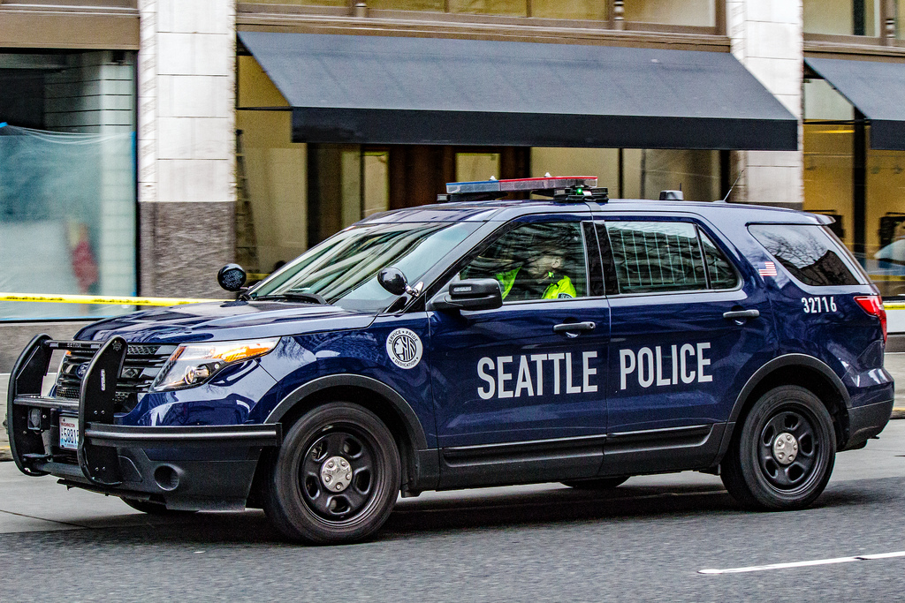
The Objective
As technology continues to grow, data becomes increasingly important
“Information is the resolution of uncertainty” ~ Claude Shannon
Predict future situations
Prioritize limited resources
In this challenge
Study existing Seattle police data
Clean up the data
Visualize the data
Analyze the data
Propose a solution to improve public safety within that area

Slide 3


Brainstorming
Initially, we looked at Fire Data
Wanted to observe the density of fires within Seattle - goal to reduce arson and prevent accidental fires
Based on that we could have more fire departments in a certain area, hydrants, etc.
Heat maps
However, we wanted relate more to Seattle police
Police 911 incident reports was “dirty data”
Used R to cut out 6 years of data (2009-2014) and 10 unnecessary columns to clean it up

Slide 4
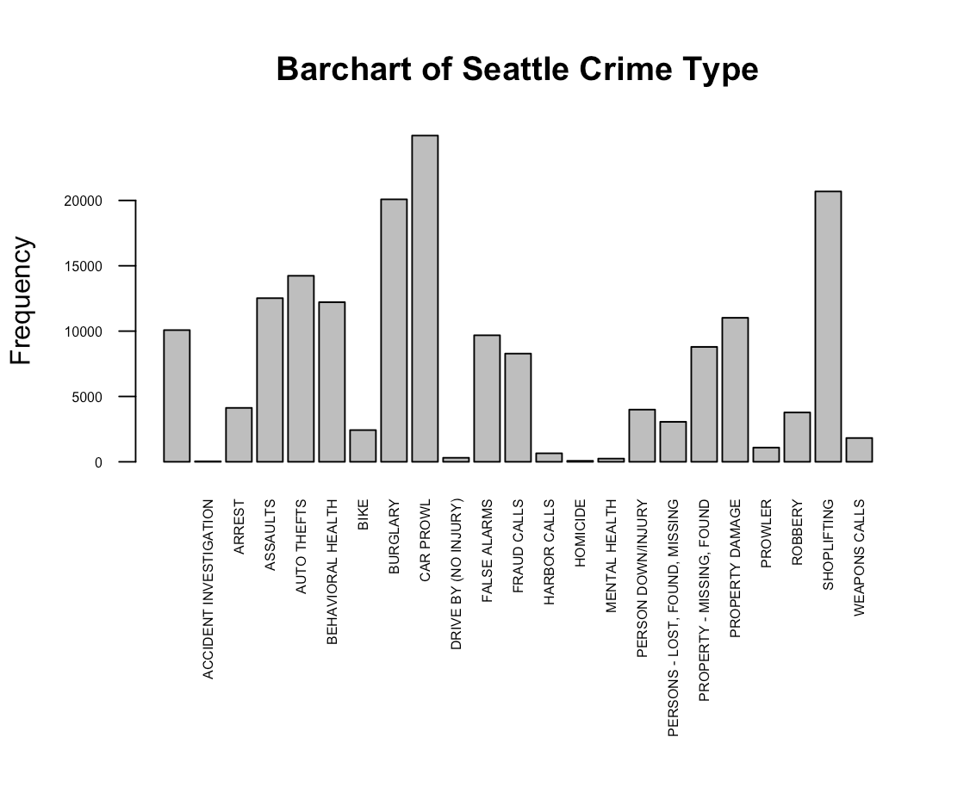
Summary of Crimes
Distribution of Crime Types
X-axis: types of crimes
Y-axis: frequency
Most frequent crimes
1. Car Prowl
2. Shoplifting
3. Burglary

Slide 5
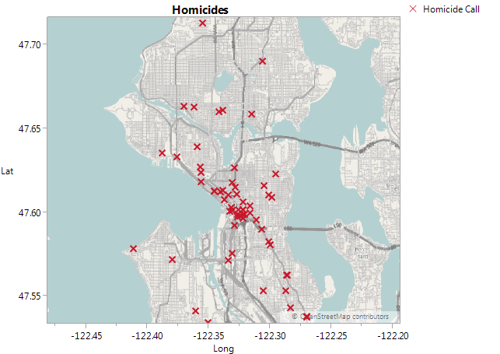
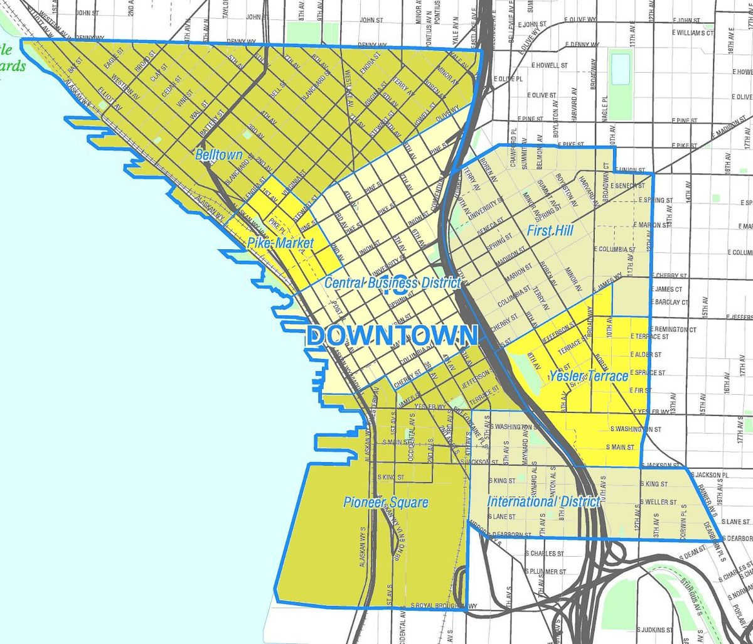
Homicide Heat Map

Slide 6
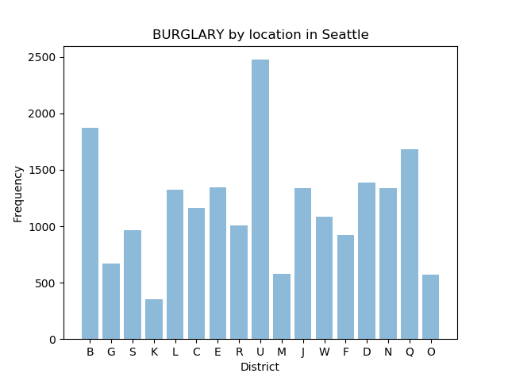
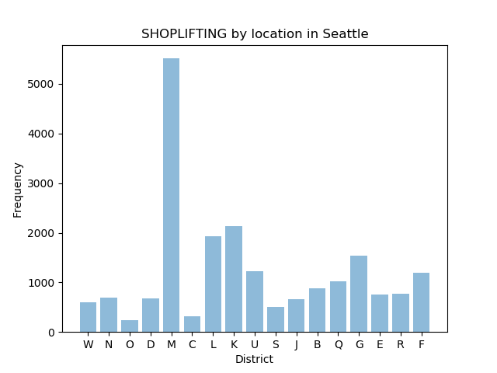
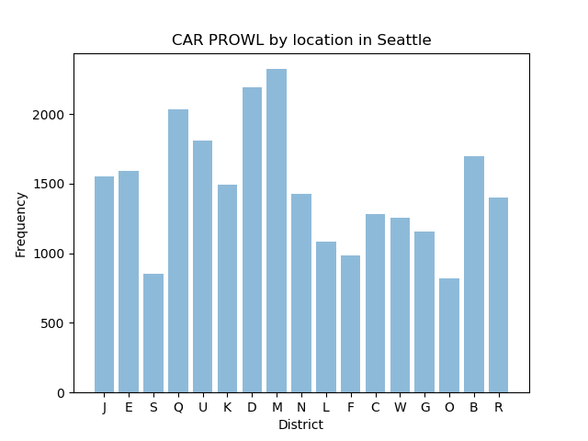
Seattle Crimes by Location
Districts U and B are all residential
District M, the Commercial District in Downtown Seattle, has almost 50% of all shoplifting reports
Seven districts are affected

Slide 7
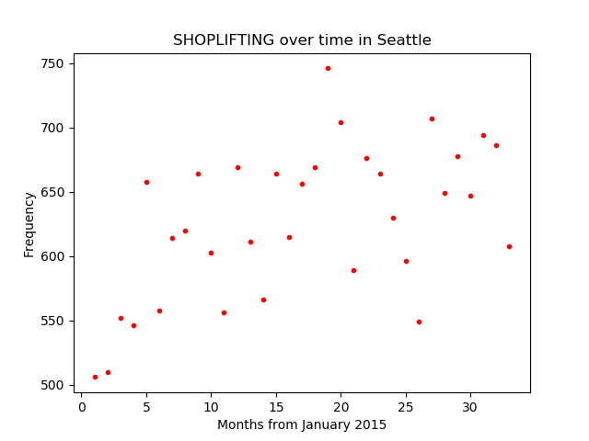
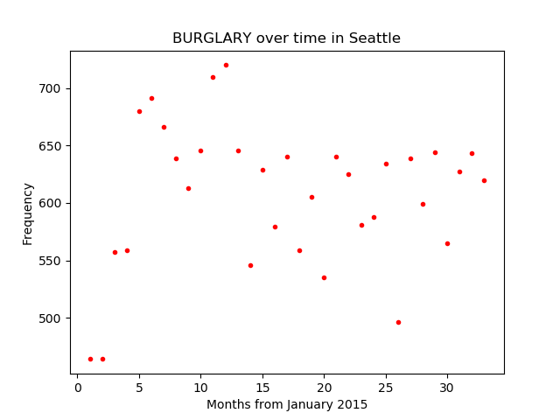
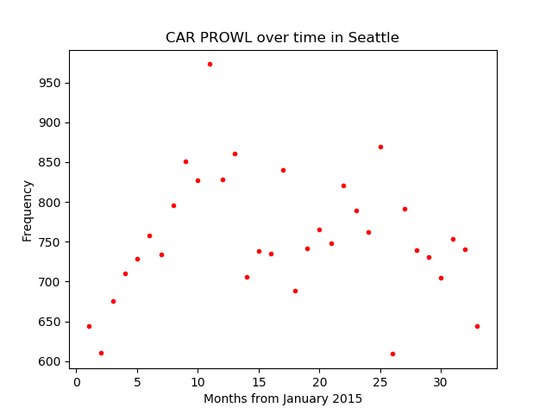
Seattle Crimes over last 3 years
Shoplifting sees an increase around the month of July
Burglary seems to be stable throughout the year
Car prowling peaks during the summer

Slide 8
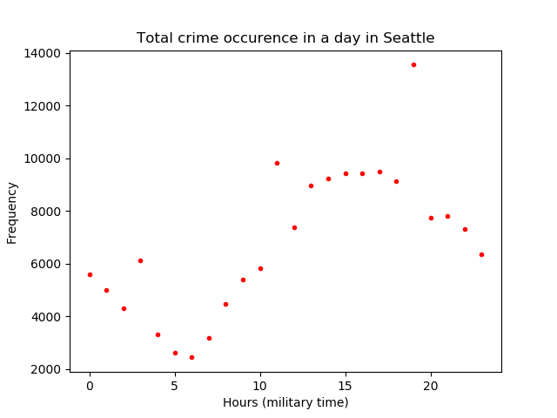
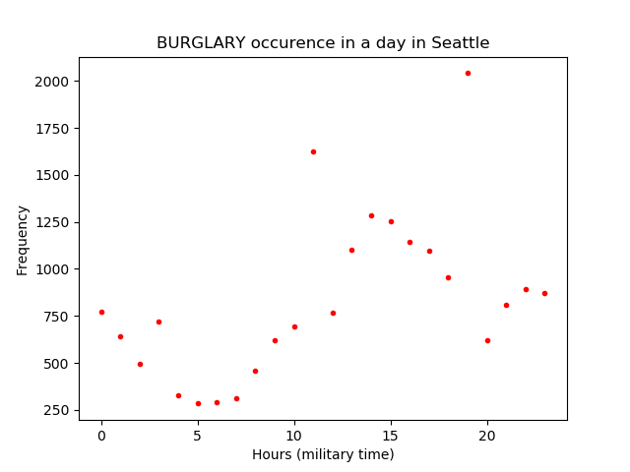
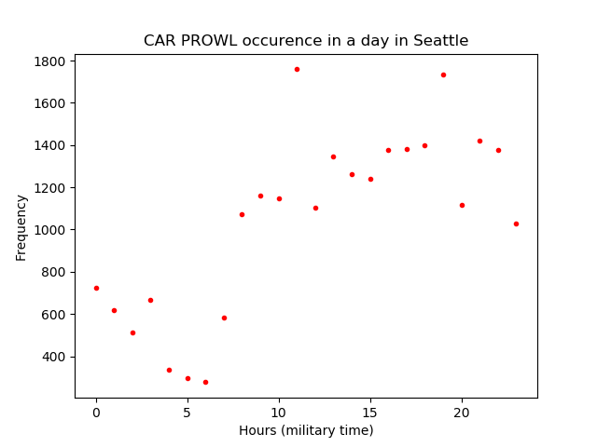
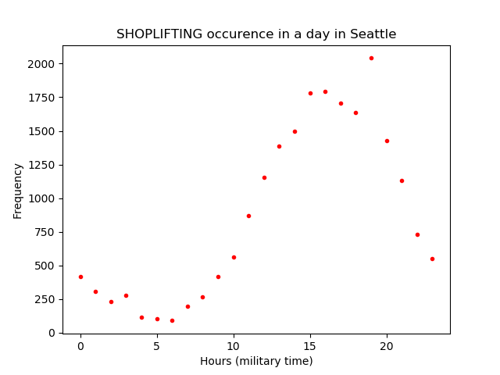
Seattle Crimes in 24-hour period (past 3 years)
All top crimes show an increase in the early to late evening
Approximately 3 p.m.
Burglary is peaks twice at late afternoon and early morning
Around 3 p.m. and 11 p.m.
Car Prowl is most common at late evening to early morning
From 8 a.m. to 11 p.m.
Shoplifting peaks during evening hours
From 8 a.m. to 6 p.m.

Slide 9
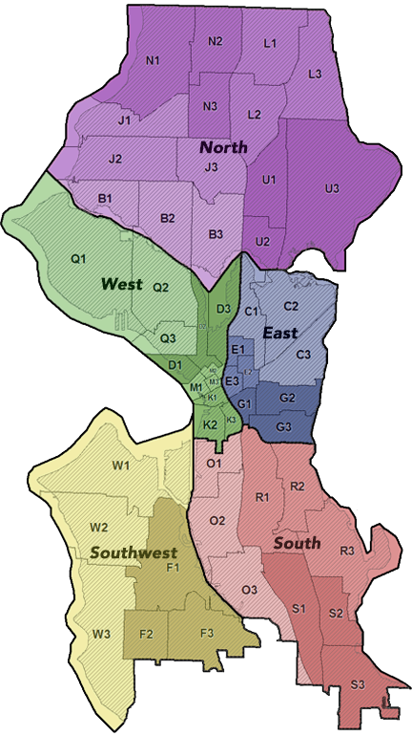
Proposals
Shoplifting dense in the M Zone (Downtown)
Reach out to business owners on better monitor and surveillance systems
M district is also has the highest frequency in homicide rates
Increase security during specific times of day
Reallocate police officers from lowest crime districts to the times and districts with highest crimes.

Slide 10
Sources
https://www.r-project.org/
https://www.jmp.com/en_us/home.html
http://ggplot2.org/
https://matplotlib.org/
https://data.seattle.gov/Public-Safety/Seattle-Police-Department-911-Incident-Response/3k2p-39jp

